Slide 1
Viscosity of Non-Newtonian Fluids
Unit Operations Lab 1
Sep 16, 2025
Miguel Piza
Ify Bidokwu
Christian Salinas Rojas

Slide 2
Introduction
Purpose:
Verify relationship between viscosity and sheer stress
Utilize Pressure drop as operating parameters
Used different capillary sizes to generate a range of shear stresses for viscosity measurements

Slide 3
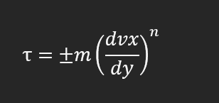
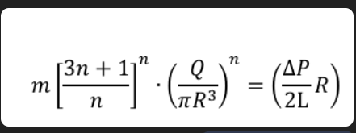
Theory
Underlying Principles/ governing equations:
Pressure gradient in capillaries will produce a volumetric flow rate
Solution is non-Newtonian which results in a non linear sheer stress and velocity gradient relationship
Relevant equations:

Slide 4
Limitations:
At low pressures the fluid struggles to maintain a constant flow rate
Substances tends to stick to the apparatus
Assumptions
Constant density of solution
Steady state flowrate

Slide 5
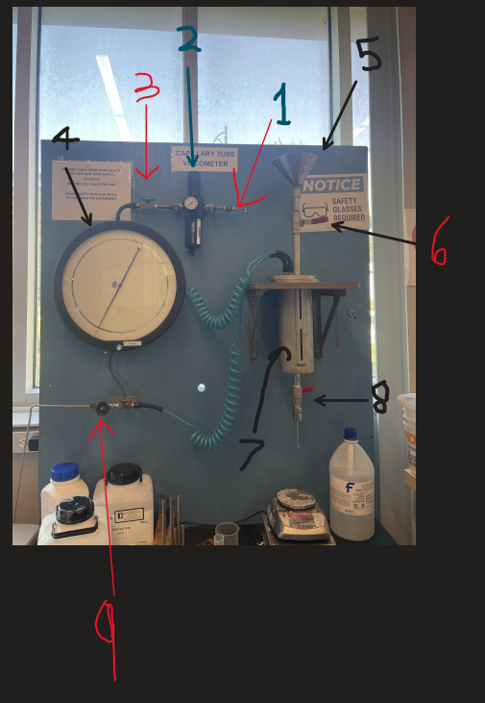
Apparatus
Air line
Regulator (pressure changes)
Inlet air valve
psi gauge
Funnel (unused)
Funnel valve (unused)
Material vessel (pressurized)
Material outflow valve (pressurized)
Outlet air valve

Slide 6
Material & Supplies
Materials and supplies :
CARBOPOL POWDER
Various Capillary tubes
1M NaOH
Compressed air
Warm tap water

Slide 7
Procedure
Create 1.0 wt% solution of CARBOPOL and water
Mix solution
Neutralize to a pH of 5-7 using 1M NaOH (~30ml )
Fill apparatus and take measurements at varying pressures and flow rates
Take density measurements

Slide 8
Experimental Challenges
Difficulties:
Ensuring constant flow rates (trapped air in material)
Obtaining density measurements
Adjust pressure once tube is opened
Proper mixing of solution
Time spent waiting for mixer
Refilling material

Slide 9
Safety
Hazards:
Highly Acidic
Initial solution has pH of 2-3
Non-toxic when neutralized with 1M NaOH
Pressure hazards
Preventing Splashing (specially when mixing)

